Slide 1
The Need for African Americans in the Global Mission Field

Slide 2

RMNi.org
Jim Sutherland, PhD, Director
423-822-1091

Slide 3

What is Christian Missions?

Slide 4
A Basic Definition of Missions
Christian mission brings the message of salvation in Christ alone to all ethnic groups so that they have the undisputed opportunity to become new persons in Christ (2 Cor. 5:17).
  Matthew 24:14 And this gospel of the kingdom will be preached in the whole world as a testimony to all nations, and then the end will come. (The NIV is used, unless noted.)
  Romans 15:20 It has always been my ambition to preach the gospel where Christ was not known, so that I would not be building on someone else's foundation.
  Luke 24:46 He told them, "This is what is written: The Christ will suffer and rise from the dead on the third day, 47 and repentance and forgiveness of sins will be preached in his name to all nations, beginning at Jerusalem.
Mission glorifies God by bringing new worshippers to Him “from every nation, tribe, people and language”—Rev. 7:9-10.

Slide 5
A Broad Definition of Missions
More generally, mission is continuing to do Jesus’ work.
  “As the Father has sent me, I am sending you.”--John 20:21 (out of our comfort).
  “The Son of Man came to seek and to save what was lost.”—Luke 19:10
  To destroy the Devil’s work—1 John 3:8—where do you see the Devil at work?
  “preach Good News to the poor…free the prisoners…release the oppressed”—Luke 4:18—where do you find oppression?

Slide 6
WHAT IS A CHRISTIAN MISSIONARY?
A Christian missionary is God’s ambassador bringing the message of salvation in Christ alone to another people, so that members will have the opportunity to be born from above.
  John 3:3 In reply Jesus declared, "I tell you the truth, no one can see the kingdom of God unless he is born again."
  This is a narrow definition of classic mission. Certainly Christian support personnel and those in mercy ministries in cross-cultural ministries are missionaries.

Slide 7
Distinguishing Traits of a Missionary
A missionary is sent by God on a task. The word “missionary” is the Latin equivalent of the Greek “apostle,” or “sent one.”
A missionary usually goes to a different culture and ethnic group. Paul went to Gentiles and Peter to Jews (Gal. 2:8).
  This distinguishes them from “witnesses,” the work of every Christian, and from local evangelists.
Missionaries are sent by God, through the Spirit, usually by local churches (Acts 13:3).

Slide 8
Missionaries are Called by God
Missionaries are distinguished by a “call” from God (Acts 13:2), although some believe Matt. 28:18-20 (“the Great Commission”) suffices for a call to everyone.
  The call may be to a specific people—however defined, to a country, or to a kind of ministry, such as teaching or medicine.

Slide 9
A Missionary is Not:
Someone who simply does the work of a deacon, as important as this is:
  Comforting the grieving
  Taking food to the hungry (Acts 6:1-4), etc.
Someone who does the work of an evangelist among his or her own people.
“If everyone is a missionary, then no one is a missionary.” It has been defined away.

Slide 10
A short history of the African American missionary force

Slide 11
Perhaps 70 African American global missionaries served between 1790 and 1820¹.
Perhaps another 600 served in Africa between 1820 and 1980².
A survey in 1973 concluded that there were probably 240 missionaries³.
102 were identified in 1998⁴, with another 140 likely. Possibly 500 serve today, far less than 1% of the 118,600 US foreign missionaries⁵. African Americans are about 13 percent of the US population.
1 Marilyn Lewis, www.urbana.org/_articles.dfm?Recordid=230
2 Sylvia Jacobs, “African Missions and the Af-Am Christian Churches,” p. 22, Encyclopedia of Af-Am Religions, 1993.
3 Robert Gordon, “Black Man’s Burden,” Evangelical Missions Quarterly, Fall 1973, pp. 267-276.
4Jim Sutherland, Ph.D. dissertation, www.RMNI.org/dissertation, p. 5
5 World Christian Database, 2005

Slide 12

Outstanding AFRAM Missionaries
John Marrant by 1775 had somehow preached the Gospel to the Cherokee, Creek, Catawar and Housaw Indians.
George Liele by 1791 had established a church of 350 in Jamaica, despite persecutions.
Prince Williams established a church in the Bahamas in 1790 that spawned 164 other Baptist churches. He pastored from age 70 to 104.
Lott Carey in 1821 was the first African American missionary to Africa. He went to escape racism and to serve his motherland. He was sent by Baptists and the American Colonization Society, established to return Blacks to Africa.
Sources: Sylvia Jacobs, Marilyn Lewis, Alan Neely, Wm. Sereile, Wycliffe Translators

Slide 13
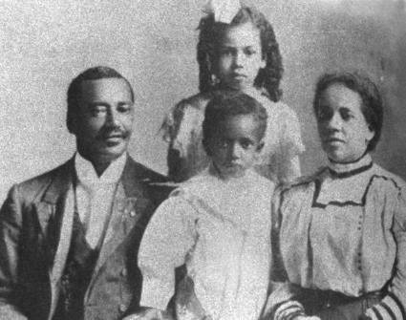
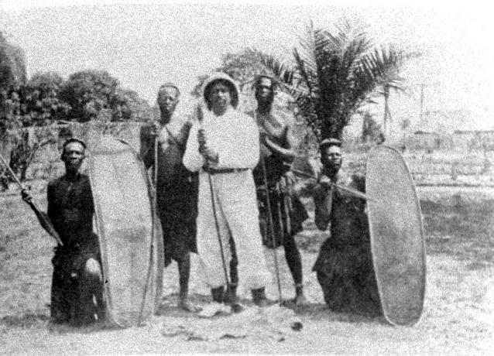
Dr. William Sheppard
Dr. Wm. Sheppard went to the Congo in 1821, becoming head of the American Presbyterian Congo Mission among the Bakuba tribe, going 1200 miles inland.
He build churches, day schools and homes for children rescued from slavery.
His wife published the first book and hymnal in the Bakuba language.
Sources: Wilbur Harr, Sylvia Jacobs, John Hendrick and Winifred Vass

Slide 14
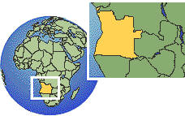
Dr. Aaron McMillan
Dr. Aaron McMillan was a physician and Nebraska legislator before going with the American Board of Commissioners in 1929 to head an Angolan hospital.
He trained assistants, treated over 80,000 patients and performed over 3,000 surgeries during his medical ministry¹.
1 Wilbur Harr, 1945. “The Negro as an American Protestant missionary in Africa”. Ph.D. dissertation, microfilm, University of Chicago, pp 54-55.

Slide 15
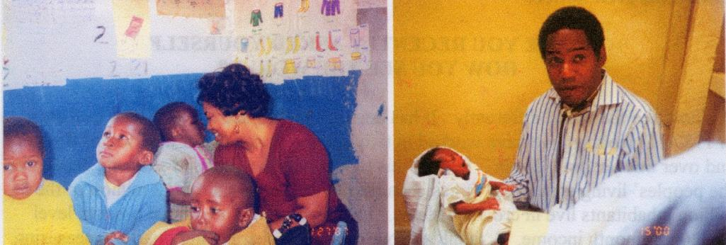
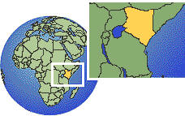
Dr. Michael & Kay Johnson
Dr. Michael Johnson serves with World Gospel Mission in Kenya, East Africa. He operates at St. Mary’s hospital and, with his wife, serves street children in the Kibera slums of Nairobi. He also trains Kenyan surgical residents.
They have a street ministry (The Least of These) to care for abandoned and orphaned children of Nairobi.
Kay, his wife, runs development projects in rural Kenya and places orphans.

Slide 16
Current Number
RMNI is currently taking an African American missionary census.
We have located at least 188 missionaries currently serving at least two years cross-culturally (April 2014).
If you know of any missionaries, please go to RMNI.org to enable us to provide an accurate count.

Slide 17
Outstanding African American Missions Churches
Particularly among newer independent churches, some give substantially.
Rosedale Park Baptist in Detroit gave 1 million to missions in 10 years www.rpbc.net
Christian Stronghold Church in Philadelphia gives $110,000 /year for global missions, & supported 5 foreign missionaries in 2002.

Slide 18
Outstanding African American Missions Churches
New Song Bible Church of Bowie, MD (Dr. Bernard Fuller, Pastor) attempts to schedule one missions trip each month.

Slide 19
Why are there so few African American missionaries?
Historically it was due to slavery, oppression and widespread racism in colonial powers and white mission organizations, particularly into the 1950s and 60s.

Slide 20
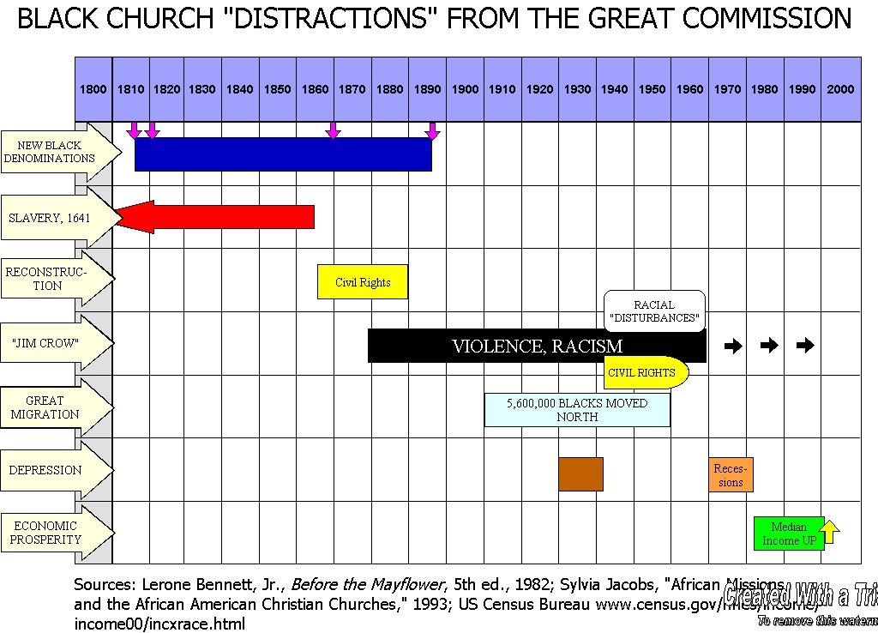
AME AMEZ CME Nat. Bapt. Conv.
Reconstruction
Sources: Lerone Bennett, Jr., Before the Mayflower, 5th ed., 1982; Sylvia Jacobs, “African Missions and the African American Christian Churches,” 1983; U.S. Census Bureau http://www.census.gov/hhes/income/income00/incxrace.html

Slide 21
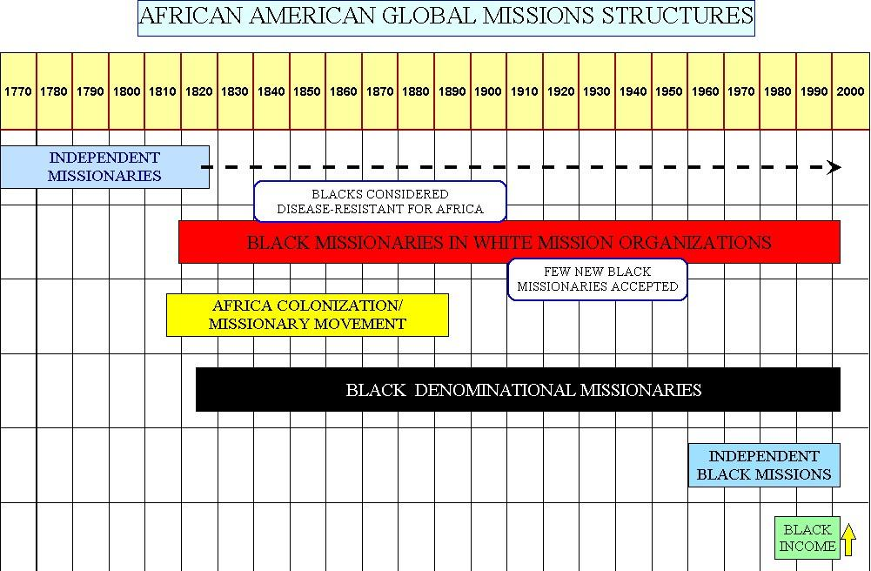
Sources: Wilbur Harr, “The Negro as an American Protestant missionary in Africa,” 1945. Sylvia Jacobs, “African Missions and the African American Christian churches,” 1993; Marilyn Lewis, “Overcoming obstacles: The broad sweep of the African American and Missions,” 2001; Wm. Seraile, “Black American Missionaries,” 1972; U.S. Census Bureau, “Historical income tables—households, Table H-5, 1967-2000”

Slide 22
Theological hindrances to fielding African American missionaries

Slide 23
Not Believing the Bible
Historically Black churches are generally as theologically accurate as white evangelical churches. However, according to a major 2007 Pew Forum survey, 59% in historically black churches hold that “many religions can lead to eternal life.” Fifty-seven percent of evangelicals believe this. This belief kills missionary motivation. Why go to others if their own religion serves as well? John 14:6?

Slide 24

Are Those Who Don’t Hear Of Jesus Really Lost ?
Those who do reject Jesus will not have eternal life in heaven (John 3:36; 12:48). JESUS said that none come to the Father apart from Him (John 14:6).
Everyone sins, but sinners don’t normally seek God (Rom. 3:23, 11-12; John 6:44). Pagans even suppress the knowledge of God obvious to them in nature (Rom. 1:18-20). They don’t accept the light already given.

Slide 25
Are Those Who Don’t Hear Of Jesus Really Lost ?
Pagans also violate their own moral standards– thus condemning themselves (Rom. 2:14-16).
Everyone comes into this world condemned by Adam’s sin (Romans 5:18). Each of us also sins individually and sin results in spiritual death (Romans 3:23; 6:23). Forgiveness comes by repentance and faith in Christ (Acts 2:38; 10:43; Romans 10:9-10). Forgiveness doesn’t come automatically by Christ’s death, or by baptism.
  If even one of the parents is a Christian, his or her child is “holy” or set apart (1 Corinthians 7:14).

Slide 26
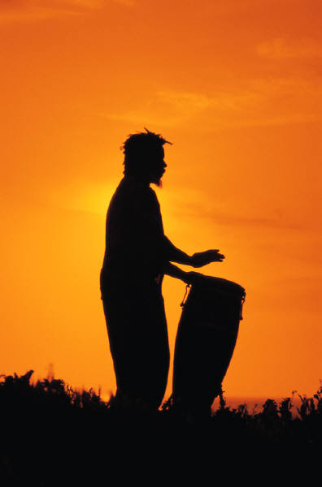
Missionary, come home?
If all are saved who don’t hear of Christ, the best strategy is to immediately withdraw all missionaries, so that all will be saved
D. James Kennedy

Slide 27
Cultural hindrances to fielding African American missionaries

Slide 28
African Americans have had to focus upon survival, then security
Very understandably, the first need of the African American church has been to care for their enslaved, then emancipated members. The Church had to care for her flock during “Jim Crow” oppression.
The Church has had to care for those disadvantaged, compared with the majority.
With the severe breakdown of the black family, and other devastating social and health problems, it has become almost second nature to assume that “We are the needy.” Why try to solve the problems of other people groups?
The problem with this thinking is that Christ has commanded His people to share their salvation with others.

Slide 29
Do We CARE that Pagans are REALLY Lost?
The people of Judah were disobedient to God, but thought that as long as they focused upon the Temple, God would not destroy it or them. They said, “We are delivered!” (Jer. 7:10). They were wrong. They should have repented (7:3).
African American churches magnify the worship service and each week proclaim God’s deliverance. “Our God is able!” “He is a “Way-maker!”— “He’s an on-time God!”
Isn’t God also interested in making a way for those who haven’t yet heard of Christ? Are we interested only in a way being made for us? If God delivered us, why can’t He use US to deliver others?
We want justice for ourselves. Is it just for us to have the Gospel, and do nothing to enable others to hear the Gospel?

Slide 30
Do We CARE that Pagans are REALLY Lost?
Many are “doing church” while disobedient to the command to go with the gospel (Matt. 28:18-20). Some appear to think that if we have CHURCH, we can forget any consequences for keeping the Gospel among our own people. “God woke us up this morning,” but do we ask about those He didn’t wake up?
In fact, God didn’t wake up about 42,000 this morning who have NEVER HEARD of Jesus Christ. Does this disturb our worship or sleep? Global missions are usually neglected in the pulpit, and the fulltime cross cultural missionary is an almost invisible church vocation.
We must reform our actions. Having church doesn’t remove responsibility for the nations. Religion is satisfied with security, staying in the Temple, and having church. God isn’t.

Slide 31
Is a slamming choir more important than missions?
Which has higher priority in your church—the choir or global missions?
Whites sometimes think that if they say something needs to be done, they are off the hook.
If our black choir sings “Send the Light!” is the church off the hook?

Slide 32
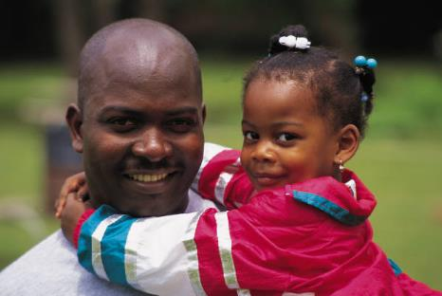
But what about our folk ?
If you protest sending money and people overseas to evangelize and serve, because needs are great at home, do you actually evangelize and serve well in your neighborhood?
Can God provide for global missions through your church, and still provide for local needs?
Is God more likely to bless a church that spreads the Good News of His Son globally, or a church that, in fact, keeps Jesus to herself?
“The light that shines the farthest shines brightest at home.” Brian Johnson

Slide 33

But what about our folk ?
Sinners are born daily among
our own people, and yes, we do have tremendous needs in our neighborhoods. We should try to meet them.
But all the ethnic churches are to partner in such a way that every ethnic group is evangelized. Our “Jerusalem” is another Christian’s “uttermost.” The Lord of the Harvest will ensure that every people group will have the Gospel as we obey.
Short-term missionaries can assist national churches and these workers return to assist home church outreach.

Slide 34
Missions as vacation ?
A church of 25,000 planned a trip to Kenya in July 2003 to see their bishop “preach to the masses.”
Members were to stay in 5-star hotels, eat at gourmet restaurants, fly in hot-air balloons and go on safari. They were also to visit their missionaries, at extra charge. They would spend more in one night at one of the hotels than they would spend on one of their missionaries in four years. At the crusade they would attend workshops. They would go to consume and enjoy—instead of to serve—encouraged by their own church to do so.

Slide 35
Missions hindered by proliferating churches
The missionary vocation is generally so obscured in the AFRAM church that AFRAM evangelists focus upon planting (stacking) churches in black communities already over-saturated with churches.
  Each requires a building, PA system, bus and support of the pastor, etc.
  Some “new wine skins” are needed. But there are peoples that are no more than .1% Christians. Why not go and plant there?

Slide 36
Missions is hindered by pastors without a global vision
The missionary vocation is so obscured that those sensing a missionary call often end up simply assisting the pastor locally. The pastor may not know what to do with this person, and only one will preach on Sunday.
  Many missionaries are sitting on the platform on Sunday mornings, instead of serving cross-culturally

Slide 37
Poor Missions Education
(David Cornelius)
Incomplete Interpretation of the Great Commission
Few Relevant Models
Failure to Relate Missions, Evangelism and Church Growth
No Comprehensive Missions Education in Churches for All Ages
Little Emphasis by Key Leaders
Poor Understanding of “The Call”
Notes:
The Basic Problem:
Lack of knowledge and/or understanding of one’s part in God’s mission.
What Scripture Says about it:
Matthew 28:20; Deuteronomy 6:6-7; Psalm 78:5-8; Proverbs 22:6
Principle:
The church is to teach her people and train them in the ways of her Lord.

Slide 38
Financial hindrances to fielding African American missionaries

Slide 39
African American Personal Finances
As of 2/2006, African Americans had an annual buying power of 762 billion dollars¹. Look at church parking lots.
Black household giving fell from 1.8% in 1998 ($658)² to 1.7% in 2005, while income rose 21 billion³. This is the first generation with a great chance to have a “piece of the rock.”
1“The US African American Market” MarketResearch.com http://www.allheadlinenews.com/articles/7002523834 accessed 1/8/07 2 www.census.gov/hhes/income/income00/incxrace.html
2 Statistical Abstract of the US 2001, Table 559, p. 360.

Slide 40
African American Mission Power
Ghana sends 500 missionaries per year. Her population is 22.1 million and her Gross National Income is 10 billion. African Americans spent 10.7 billion on household furnishings and equipment in 2004. Nigeria sends 2500 missionaries per year and has a Gross National Income of 74.2 billion dollars. African Americans spent this much on vehicles, insurance, clothing and gifts in 2004. Sources: The World Bank: http://devdata.worldbank.org/external/CPProfile.asp?PTYPE=CP&CCODE=GHA
http://devdata.worldbank.org/external/CPProfile.asp?PTYPE=CP&CCODE=NGA ; the World Christian Database and Target Market News http://targetmarketnews.com/BuyingPower05.htm

Slide 41
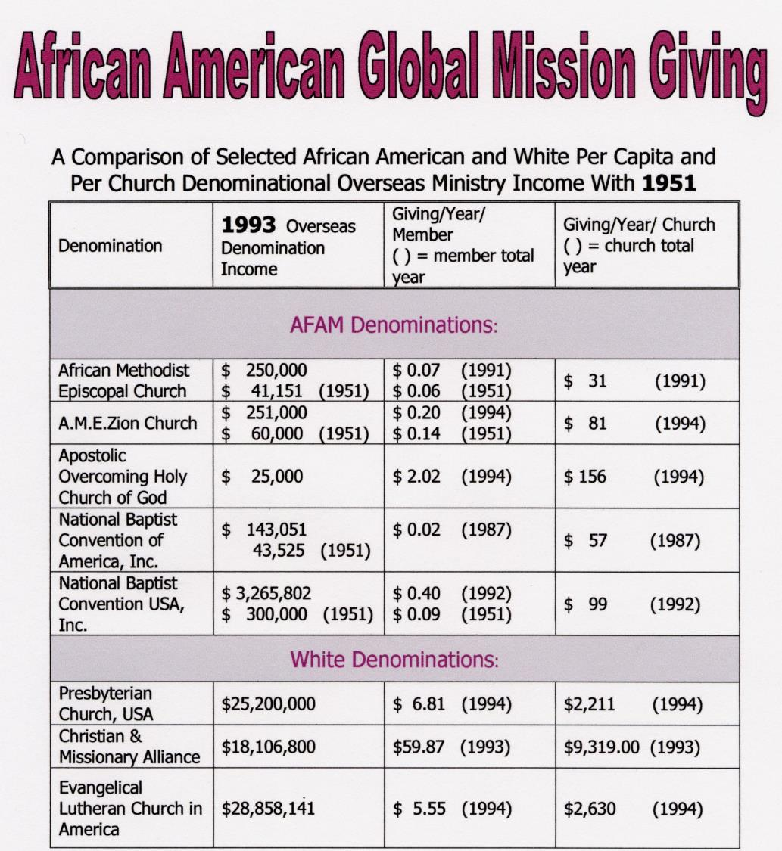

Slide 42
Two Traditional Black Churches and Global Missions
One traditional church in Chattanooga with a budget of $120,000 spent .4 % on evangelistic home missions (to Blacks).
This church spent NOTHING on global missions. More was spent on the annual men’s breakfast and on the copy machine than on missions.
Another church proposed spending over $2000/year on garbage removal, and nothing at all on missions.
How much of your church budget goes to cross-cultural/global ministry?

Slide 43
The “Missions” Switch
Money is designated on the offering envelope for “missions,” but stays either inside the church, or in the neighborhood.
“Missions” money is often lumped with local benevolences, and local needs trump regular missionary support. If someone gets burned out, “missions” money may be used to meet that need, while the foreign missionary has no recourse or voice. The greatest problem for many AFRAM missionaries is low support.

Slide 44
The “Missions” Switch
Dr. Michael Johnson, AFRAM missionary surgeon to Kenya, writes:
  “Many of the problems in our fellowships are due to the fact that we have taken money given for foreign missions and used it to build a parking lot, or buy flowers for the altar.”
    From Making the Lame Man Blind, 2nd ed., by Michael Johnson, MD.

Slide 45
Is Christianity mostly about
God serving ME ?
Some Gospel-literate churches focus upon personal peace, wholeness and prosperity.
“Many/most AFRAM are 1st generation ‘haves.’ Those who are ‘have nots’ are usually unwilling to leave all for Christ. Until 2nd generation ‘haves’ are born again few if any will leave their community to serve others. Once 2nd generation ‘haves’ move out of AFRAM stereotypes of success, a typical service can be affirmed.”
Kyshia Whitlock—African American missionary to Honduras

Slide 46
Is Christianity mostly about
God serving ME ?
Is our emphasis upon what God will do for us? Is it upon personal wholeness, health and wealth?
  Going “to the next level” means humbling ourselves to go lower, and to serve more people. The way up is down, in Christianity.

Slide 47
Is Christianity mostly about
God serving ME ?
Philippians 2:5-9 Your attitude should be the same as that of Christ Jesus: ⁶Who, being in very nature God, did not consider equality with God something to be grasped, ⁷but made himself nothing, taking the very nature of a servant, being made in human likeness. ⁸And being found in appearance as a man, he humbled himself and became obedient to death-- even death on a cross! ⁹Therefore God exalted him to the highest place….

Slide 48
What is the need for missionaries?

Slide 49
Worlds A, B & C
World A
  The unevangelized world
    =2,106,206,000 as of mid-2014, or 29% of Earth’s population
World B
  The evangelized non-Christian world
    = 2,725,635,000 in mid-2014, or 38%
World C
  The Christian world
    =2,375,619,000 in mid-2014 or 33%
Source: Todd M. Johnson & Peter F. Crossing, “Status of Global Mission, 2014, in the Context of AD 1800-2025,” Int’l Bulletin of Missionary Research, Jan. 2014, p. 29.

Slide 50
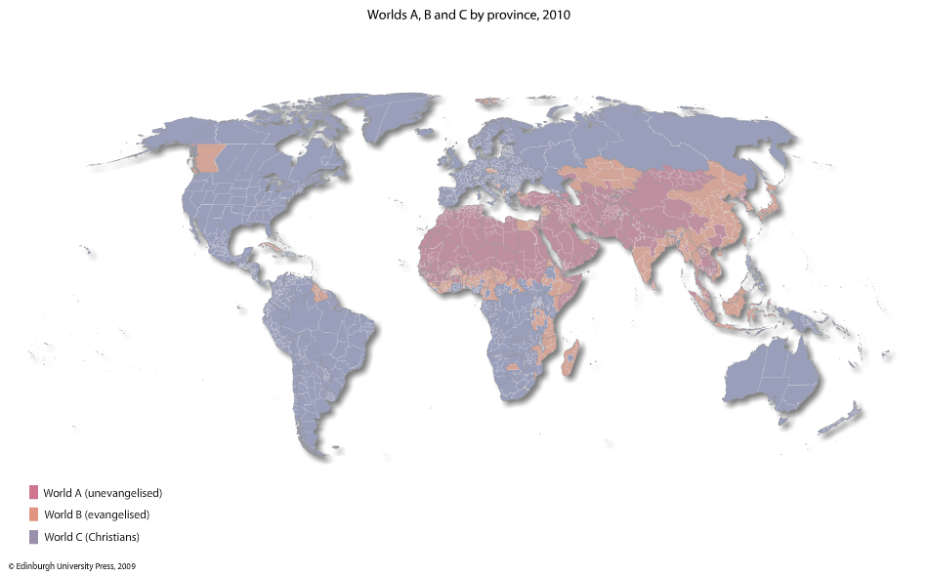
Worlds A, B & C, 2010
Todd M. Johnson, Kenneth R. Ross, eds., Atlas of Global Christianity, 2009, pp. 312-13, ISBN: 9780748632671

Slide 51
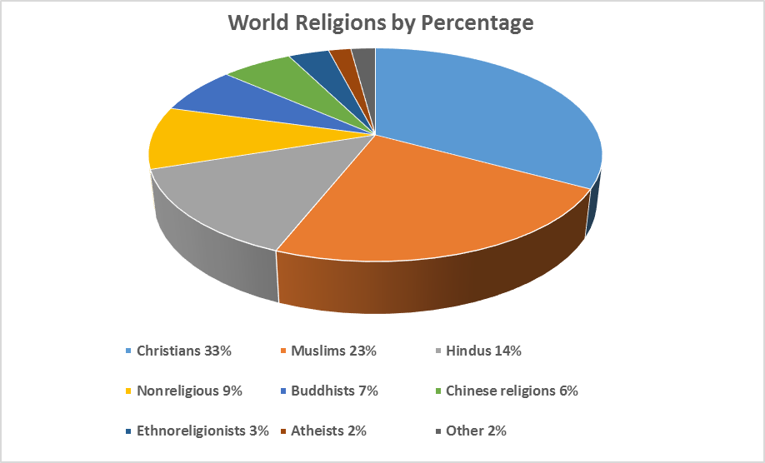
2014
Source: Todd M. Johnson & Peter F. Crossing, “Status of Global Mission, 2014, in the Context of AD 1800-2025”, International Bulletin of Missionary Research, January 2014, p. 29.

Slide 52
World Religions by Population—Mid-2014
Christians | 2,375,619,000
Muslims | 1,660,729,000
Hindus | 1,000,193,000
Nonreligious | 683,000,000
Buddhists | 513,593,000
Chinese folk religionists | 436,413,000
Ethnoreligionists | 250,672,000
Atheists | 136,553,000
Other | 150,688,000
Source: Todd M. Johnson & Peter F. Crossing, “Status of Global Mission, 2014, in the Context of AD 1800-2025”, International Bulletin of Missionary Research, January 2014, p. 29.

Slide 53
Global Evangelistic Resources
“40% of the church’s global foreign mission resources are being deployed to just 10 oversaturated countries with strong citizen-run home ministries.”
“91% of all Christian outreach/evangelism does not target non-Christians but targets other Christians, many in wealthy World C countries and cities.”
“Measures of personal evangelism by Christians indicate that 86% of all Buddhists, Hindus, and Muslims do not personally know a Christian.”
David Barrett, Todd M. Johnson & Peter Crossing, “Missiometrics 2008: Reality Checks for Christian World Communions,” Int’l Bulletin of Missionary Research, Jan. 2008, p. 29.

Slide 54
Why African American missionaries?

Slide 55
This is the Time To Engage Missions
Nations open to missionaries are open to African Americans.
Civil rights is (again) law.
White missions welcome African Americans.
Excellent schools will prepare black missionaries.
Strong, biblical African American mission boards now exist.
Black income steadily rises.
Short-term missions abound with ease of travel.

Slide 56
Why African Americans Now?
Through the furnace of affliction, slaves drew near to God and their heirs have been seeking God ever since. The African American community still has among the highest measures of faith in America.
  92% pray at least weekly
  85% say that religion “is very important in their lives”
  91% believe in heaven, and 82% believe in hell (the highest rate of any group)
Pew Forum on Religion & Public Life, Summary of Key Findings, 2007, pp. 6,11,13.

Slide 57
Global missions is not simply the job of the white church. The African American church is a full partner among the world’s sister churches.
Blacks have a unique role in world mission—especially to people of color, and particularly to the oppressed.
Blacks understand oppression and suffering well, and can easily relate to the oppressed.
As urban-dwellers, they understand the city, where probably the majority of unreached people live.
African Americans can sometimes go where whites cannot go.

Slide 58
Stewardship of personal trials
If American-Americans believe in hell the most strongly of all Americans, this belief should be a motivation to help anyone avoid it, including non-African Americans.
Not only has there been cultural oppression, there is much familial dysfunction in the African American family—many broken families. The majority of children are born outside of marriage, for example. These experiences again can be stewarded to the comfort of many.

Slide 59
You have a stewardship of affliction
2 Corinthians 1:3-5 Praise be to the God and Father of our Lord Jesus Christ, the Father of compassion and the God of all comfort, ⁴ who comforts us in all our troubles, so that we can comfort those in any trouble with the comfort we ourselves have received from God. ⁵ For just as the sufferings of Christ flow over into our lives, so also through Christ our comfort overflows.
You represent victory over affliction.

Slide 60
African Americans have a hearing
Oppressed people know that an African American can possibly become the most powerful man on the globe.
In Africa they want to know where the African American brothers and sisters are. African Americans are their success story. They want to serve in missions together with you.
African Americans can bring not only hope for this life, but have gained a hearing to present hope of eternal life with God through Christ.

Slide 61
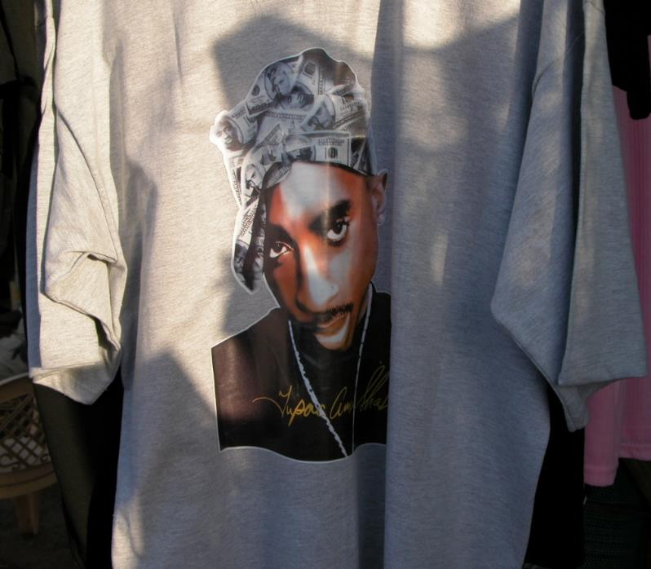
African American culture has it “going on” globally
This T-shirt with deceased rapper Tupac Shakur’s image on it was hanging in a booth in Torit, Southern Sudan, July 2008. On TV in India are Hindu-style rappers. In mini-buses in Kampala you can hear rap songs. What other culture has so dominated global music? Japanese want to listen to high-energy black choirs. The choir can become a mission outreach. African Americans are seen as part of a cool, dominant, successful culture.

Slide 62
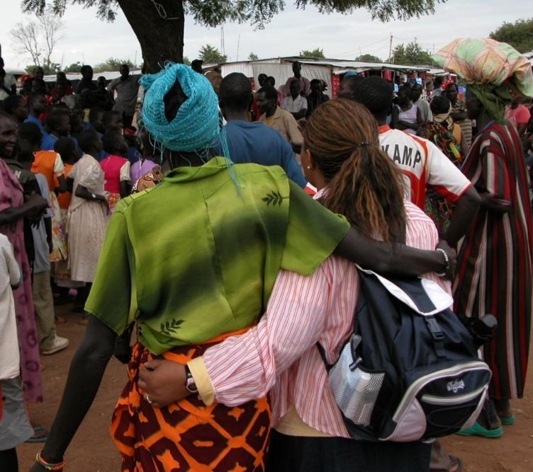
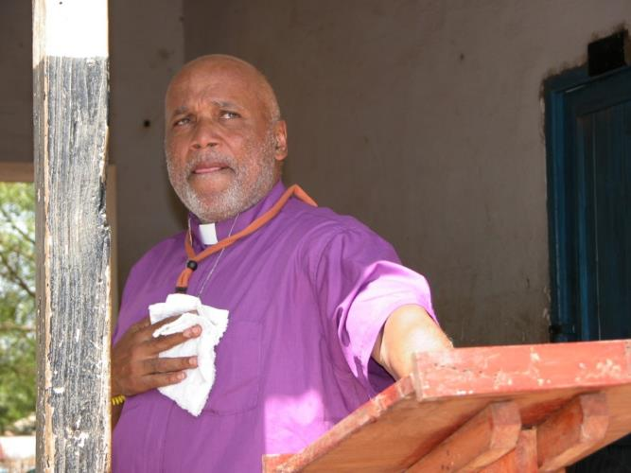
Africans and African Americans have an affinity in mission
Pastor Larry Arnold, Eagle’s Nest Comm. Church of Atlanta, Georgia, describing how deeply ministry in Sudan in 2008 had impacted him
Margo Williams (right) with one of the ladies she taught during four days in Sudan.

Slide 63
The African American church needs global missions
As the African American church engages global mission, losing her life, sending out her resources of funds and people, she will save her life.
Church members will experience revival, not just attend revival meetings.
Obedience to God in sharing the Gospel globally may or may not add members to the local church, but obedience is simply right, regardless of consequences.

Slide 64
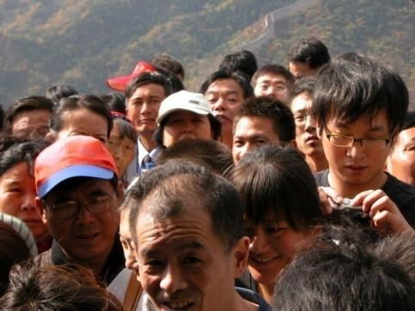
If you don’t go….
In China Christians have been
persecuted for their faith for over
60 years.
  Chinese have had a vision since the 1920s to take the Gospel back to Jerusalem via the Silk Road, going to the 10/40 Window. This means evangelizing Buddhist, Hindu, and Muslim peoples along the way. They hope to send 100,000 missionaries. http://ctlibrary.com/ct/2004/april/5.84.html
  I asked the leader of a fellowship of 4.5 million Christians if his people resisted going globally. He didn’t understand the question. They don’t hesitate going even to arch-enemy Japan.

Slide 65

Back to Jerusalem
Another Chinese fellowship
of 7 million Christians has trained 300 cross-cultural workers in two missionary-training schools, deployed mostly inside China.
A third fellowship of about 7.5 million believers has global missions as their first priority.
A fourth fellowship of 3 million believers has two missionary training schools and about 45 missionaries distributed in Pakistan, Burma, Yemen, and Cambodia, as well as in every mainland province except one.

Slide 66
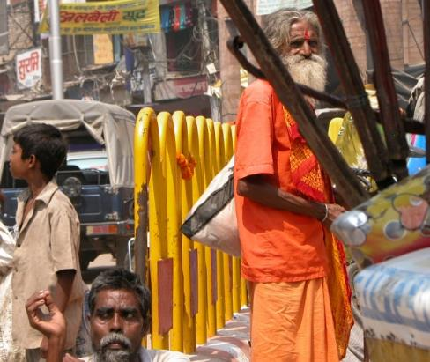
To Unreached Indians
Although less than 1.5% of the
population of India’s Uttar Pradesh province of 183 million people, Christians are
targeting every district in that province for church planting, despite persecution.
  I visited one ministry in Uttar Pradesh that is working to plant 10,000 house churches, and to win 200,000 Indians to Christ by 2012. They have already planted 1114 house churches since 2003 and seen 20,000 professions of faith.

